Slide 1
Estimation of Unit Area House Prices in a Specific Area Using Multiple Regression Analysis and Correction of Residual Assumptions Using Appropriate Method
Name: Vika Valencia Susanto
NIM: 2440062123
Link video: https://youtu.be/t6XYk9B4Nns

Slide 2
Introduction
Problem stated Real estate business transaction causing the valuation of real estate increase, making the house pricing is unstable, uncertain, and unpredictable.
Objective
Benefit
Based on the problem stated, investors and buyers will need a system or model to predict house prices and valuation based on several housing aspects
Conduct the best model to find out the range of house prices to be the consideration in buying and selling houses.
Determine which factor has a significant effect on house price based on the factor used in the data set and model conducted

Slide 3
MetHods
Multiple Linear Regression Multiple linear regression is an extension of linear regression that refers to a statistical approach to predict the outcome variable based on the two or more variables. The dependent variable is the variable we aim to predict, and the factors we use to forecast the value of the dependent variable are known as independent or explanatory variables.
Ordinary Least Squares OLS) is a widely used method for calculating the coefficients of linear regression equations that describe the connection between one or more independent quantitative variables and a dependent variable (simple or multiple linear regression).

Slide 4

Assumptions of Multiple Linear Regression To conduct a good regression models, several assumptions must be fulfilled, which are: 1. The errors εi where i = 1, 2, …, n, have a normal distribution or normality assumption; 2. The attributes xi where i = 1, 2, …, n, have no multicollinearity; 3. The errors εi where i = 1, 2, …, n, have homoscedasticity; 4. The errors εi where i = 1, 2, …, n, have no autocorrelation.
Normality test (Kolmogorof Smirnov) The normality test serves to assess the likelihood that the residuals are normally distributed. The normality test hypothesis is: - H0: The errors are normally distributed - H1: The errors are not normally distributed
Heteroscedascity Test (Breusch-Pagan) The Breusch-Pagan test is one of the most popular methods to test for heteroscedasticity, which describes if the residuals are homoscedastic (independently identically distributed) or not. The hypothesis of the heteroscedasticity test is: - H0: The errors are homoscedastic - H1: The errors are heteroscedastic

Slide 5
Autocorrelation Test (Durbin Watson) The degree of correlation between two consecutive time intervals is referred to as autocorrelation. It assesses the relationship between the lagged version of a variable's value and the original version in a time series. Durbin Watson test is used to test autocorrelation in data. The hypothesis for autocorrelation test: - H0= no autocorrelation exists - H1= autocorrelation exists
Multicollinearity Test In regression analysis, the Variance Inflation Factor (VIF) evaluates the severity of multicollinearity. It's a statistical notion that describes how collinearity increases the variance of a regression coefficient.
Robust Regression Robust Regression is a form of regression analysis designed to overcome some limitations of traditional parametric and non-parametric methods, such as to handle the violation of normality test

Slide 6
Dataset
This study is based on the “Real Estate” dataset obtained from Kaggle with a total of 414 observations, and 7 attributes from 2018.
The data has limited description about each attribute, however the best guess of explanation is the following:
Transaction Date: -
House Age: Age of the house
Distance to the Nearest MRT: The distance to the nearest MRT station
Number of Convenience Stores: The number of convenience stores per unit of radius
Latitude: Latitude point of the house
Longitude: Longitude point of the house
House Price Unit Area: House price per unit area

Slide 7
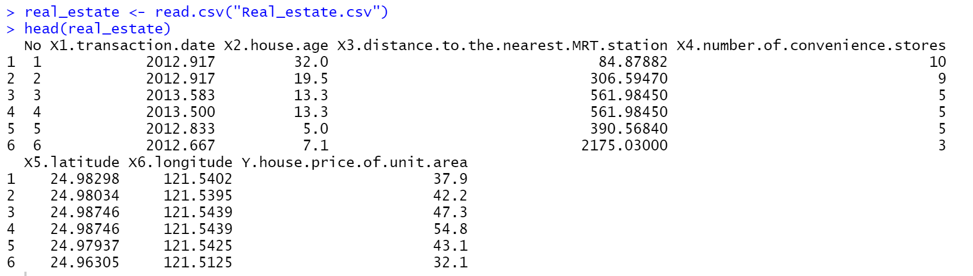

Slide 8
Methodology
Regressor Variable Selection
Model Development using OLS Method
Tests on Residual Assumptions
Model Modification based on Residual Assumptions Violation (if needed)
Determining the most Optimal Regression Model

Slide 9
Result
The simplest regression equation to estimate the House Price of Unit Area will be conducted using backward elimination method with the predictor variables that will be used are house age, distance to the nearest MRT, number of convenience stores and the predicted variable is house price unit area.
The variables longitude and latitude can not be used directly, as it is unlikely there is a true linear relationship. Those variables will be applied if they have already been converted into variable like geodesic distance.
Variable selection is used to determine which variable will be used as the regressor

Slide 10
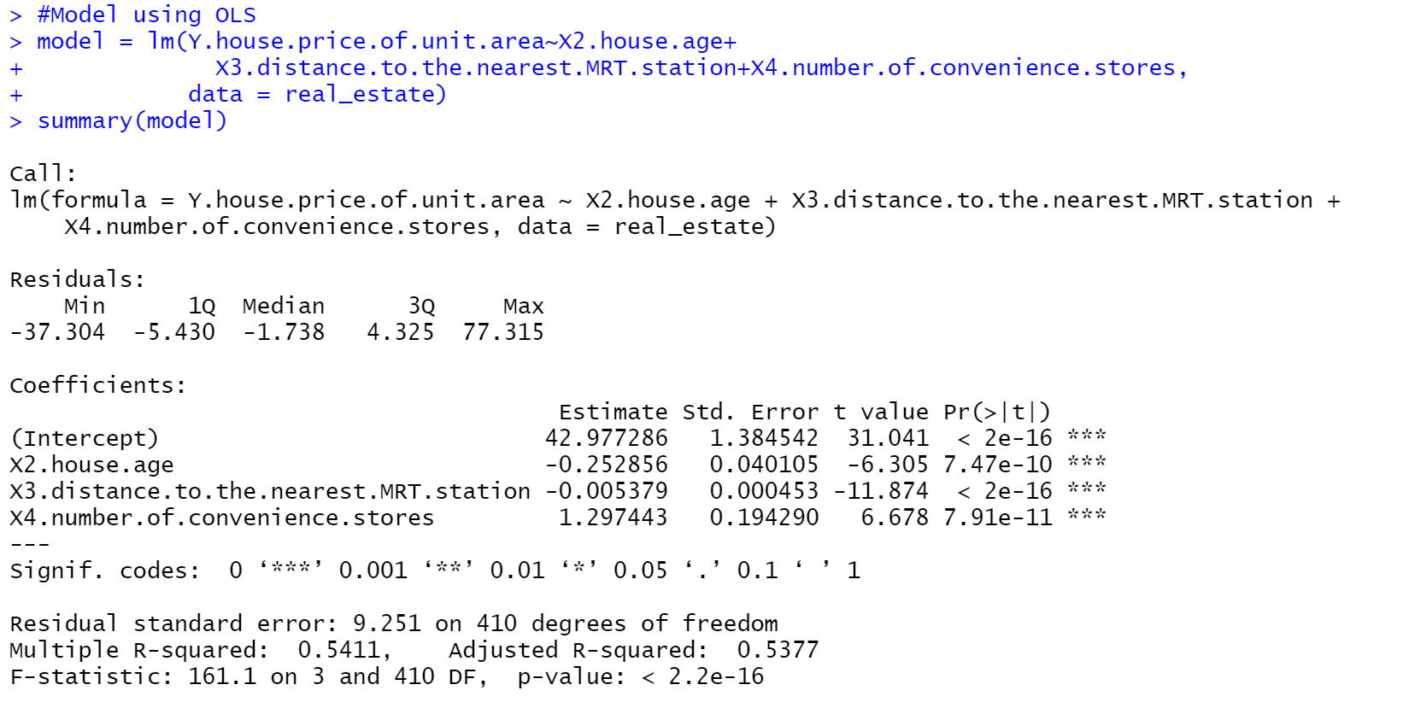

Slide 11
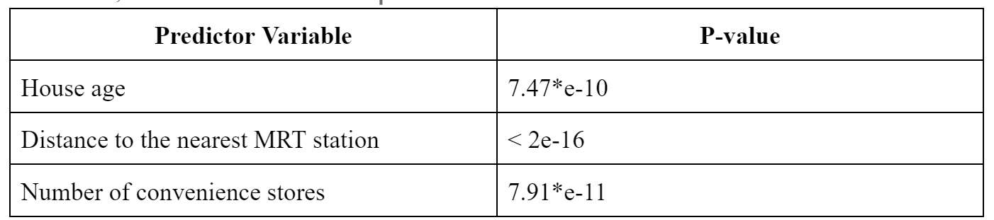
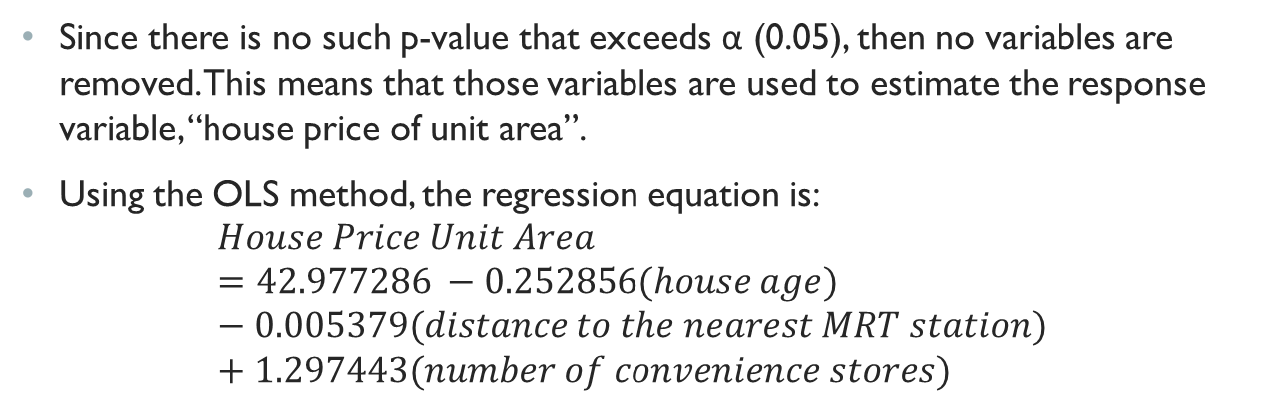
Since there is no such p-value that exceeds α (0.05), then no variables are removed. This means that those variables are used to estimate the response variable, “house price of unit area”.
Using the OLS method, the regression equation is:
$$House Price Unit Area =42.977286 −0.252856(house age) −0.005379(distance to the nearest MRT station) +1.297443(number of convenience stores)$$

Slide 12
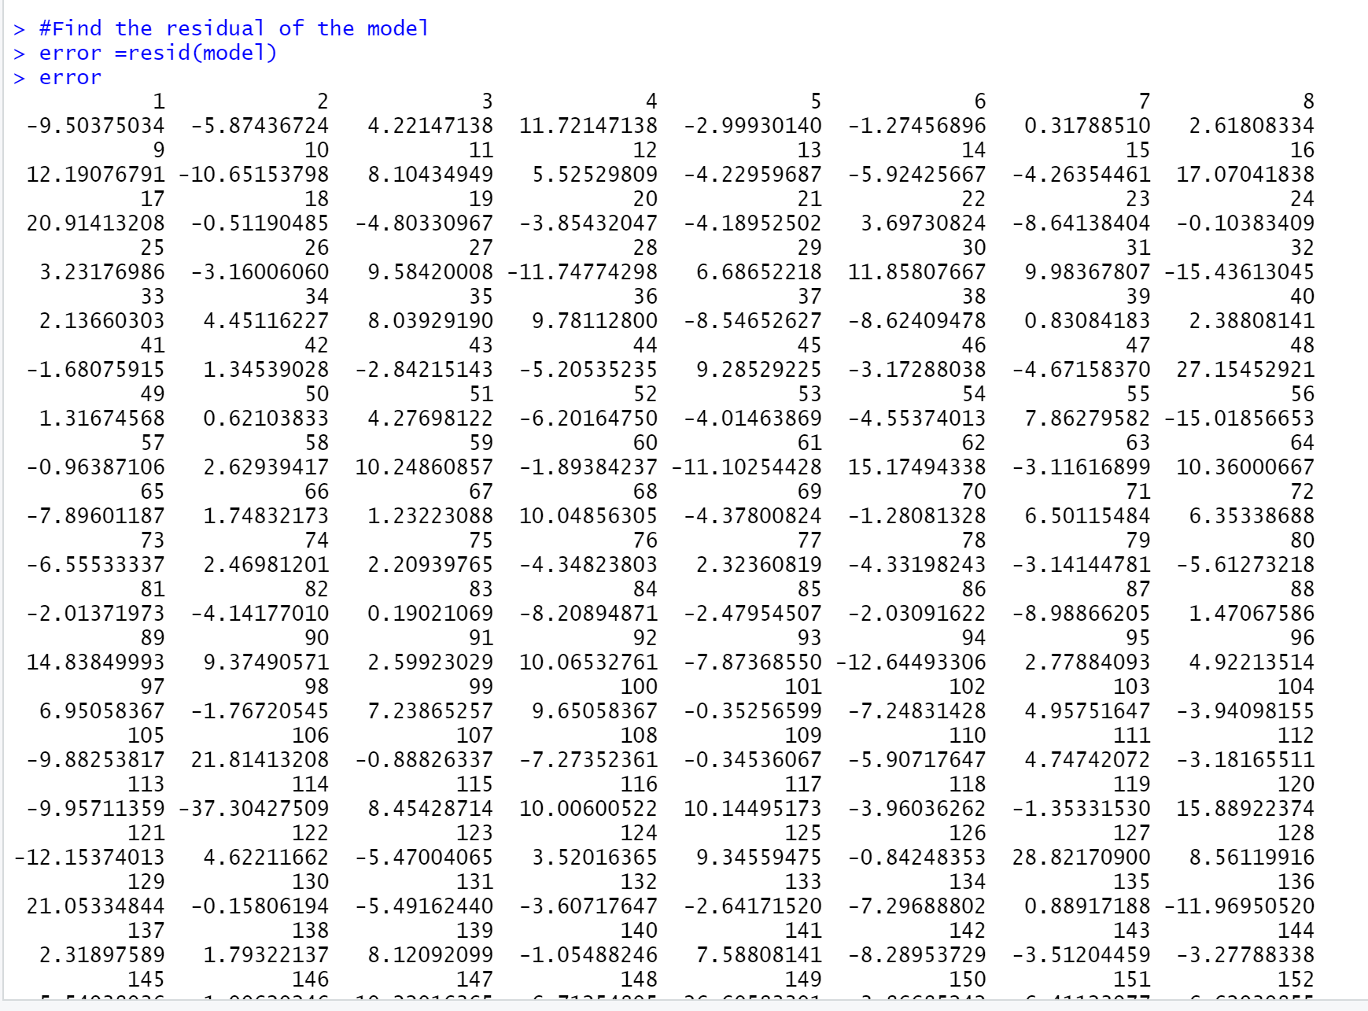
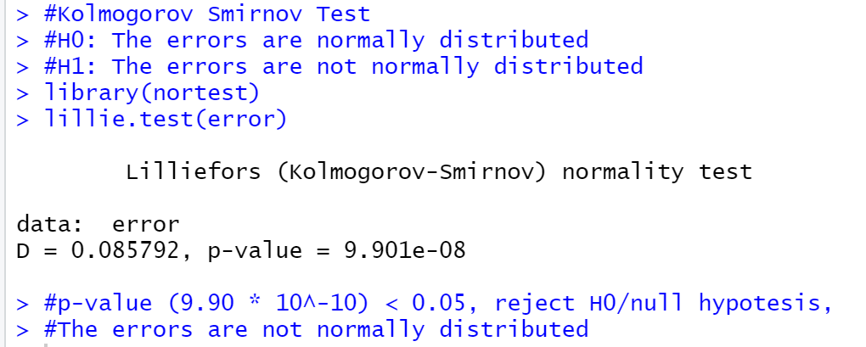
To carry out a good regression model, check this regression equation's residual assumption next. As mentioned in the methods section, the tests utilized are the Kolmogorov-Smirnov, Durbin-Watson, and Breusch-Pagan tests.
The desired outcome is P-value bigger than α (0.05), which suggests that all of the null-hypotheses fail to be rejected.

Slide 13
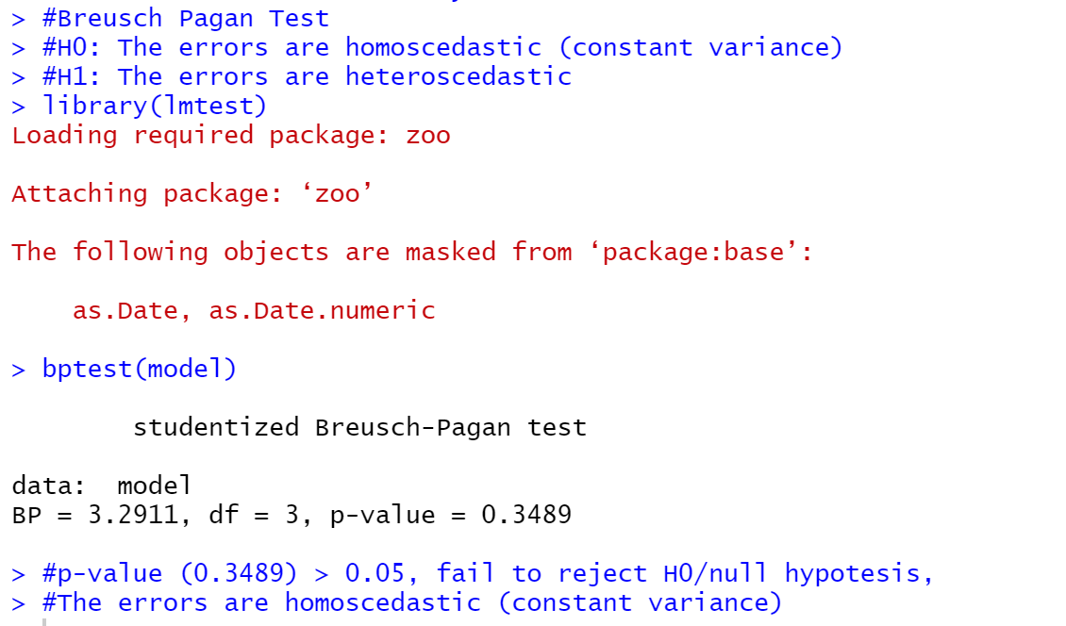
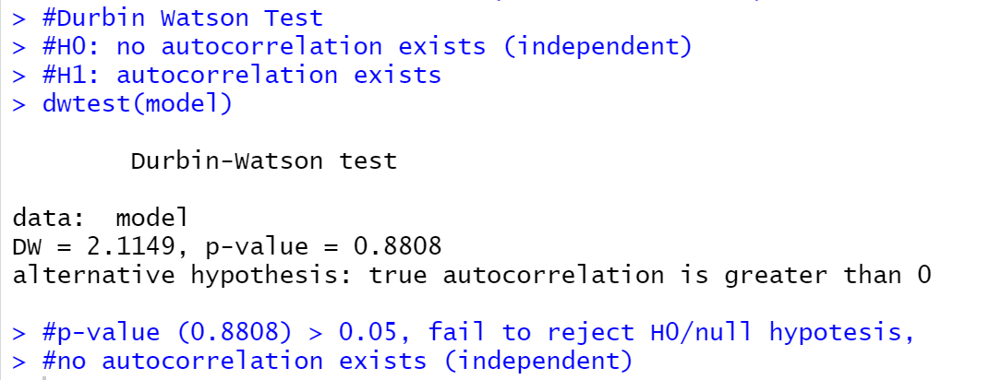

Slide 14
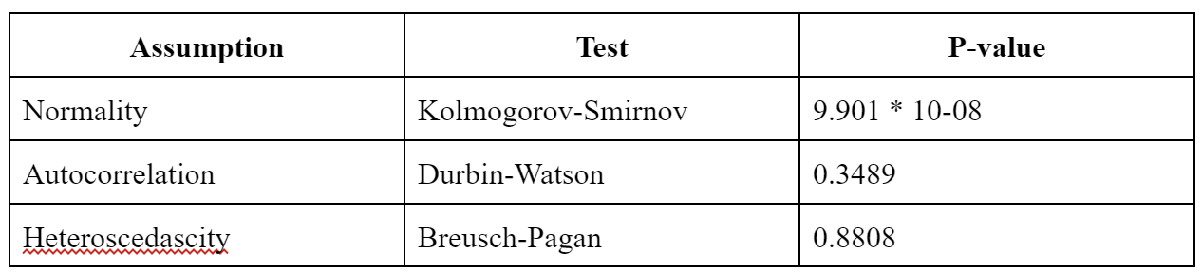
The p-value for the regression model in each test is displayed in the table below.
Since, only the Kolmogorov-Smirnov Test conducted the p-value les than 0.05, then reject H0, which means the error is not normally distributed

Slide 15
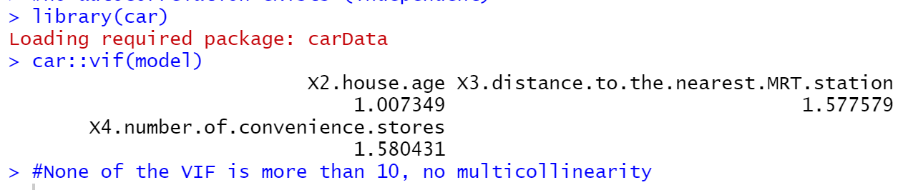
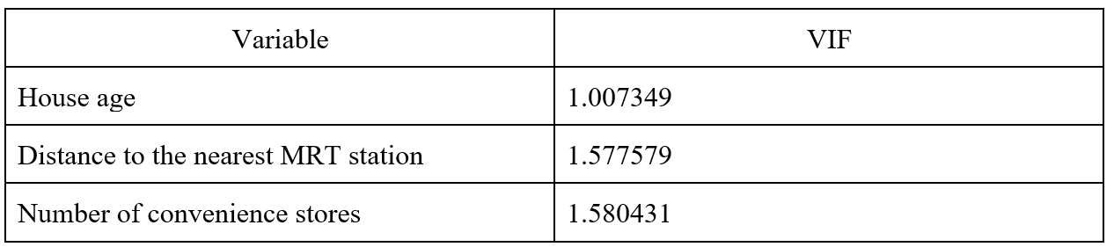
Using the multicollinearity test, determine whether each variable's VIF score is greater than 10 or less than 10. The variable has multicollinearity if the VIF score is larger than 10, according to the definition.
Since there is no variable with VIF more than 10, it can be concluded that there is no multicollinearity.

Slide 16
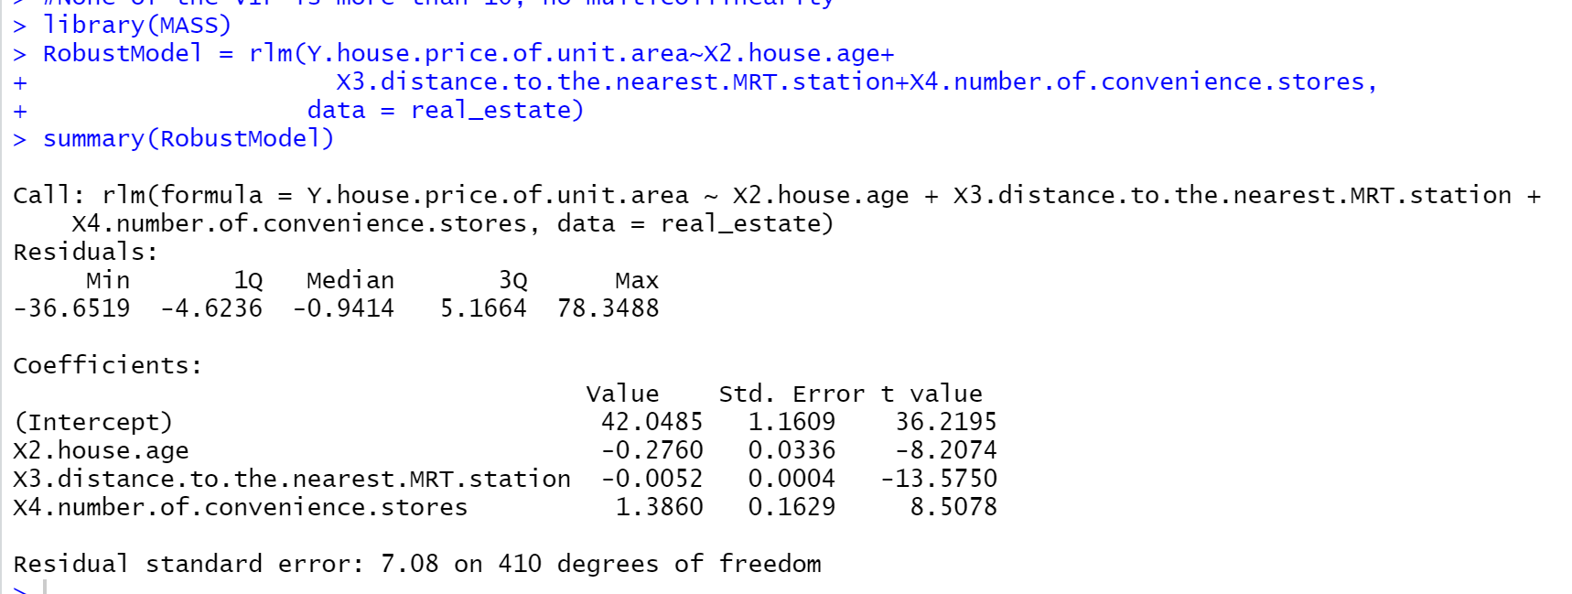
According to the outcome shown in the table above, the model does not satisfy the residual assumption in the Kolmogorov-Smirnov test for normality, which shows that the model is not normally distributed.
Regarding this violation, the Robust Regression approach is the best regression model to satisfy the normality assumption.

Slide 17
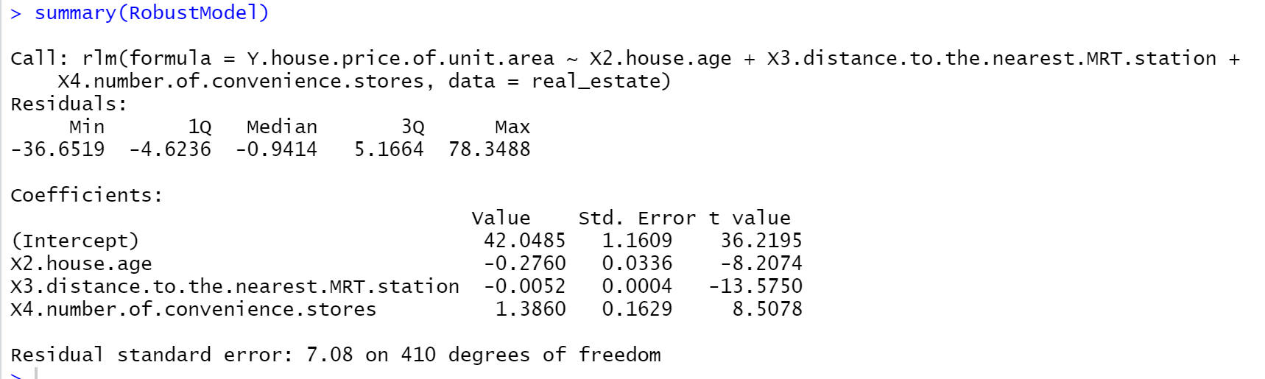
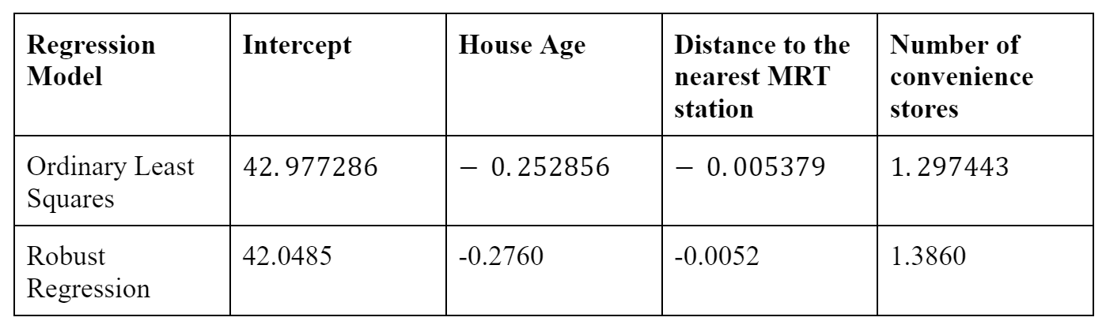
Based on the summary of the model, the regressor coefficient for each model are:

Slide 18
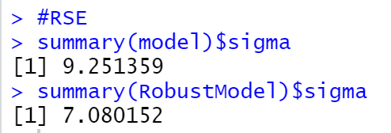
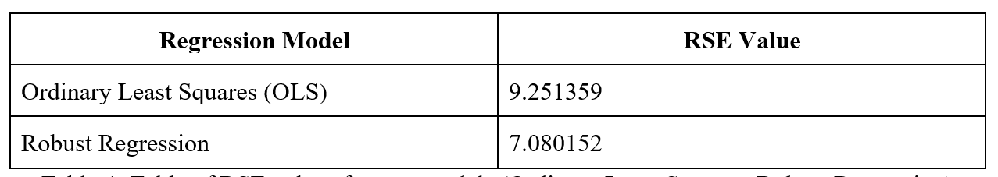
The residual standard error (RSE) was chosen in this study as the indicator of how well our created regression models performed. The better a regression model fits our data, the lower its RSE value should be. The RSE for both models are shown below.

Slide 19
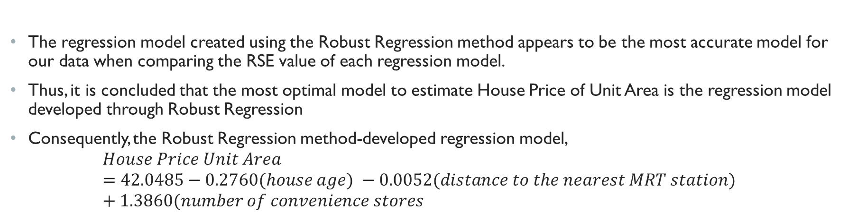
The regression model created using the Robust Regression method appears to be the most accurate model for our data when comparing the RSE value of each regression model.
Thus, it is concluded that the most optimal model to estimate House Price of Unit Area is the regression model developed through Robust Regression
Consequently, the Robust Regression method-developed regression model,
$$House Price Unit Area =42.0485−0.2760(house age) −0.0052(distance to the nearest MRT station) +1.3860(number of convenience stores$$

Slide 20
Conclusion
By creating a regression model using the Robust Regression approach and using the house age, distance to the nearest MRT, and number of convenience stores as the predictor variables, it is feasible to generate an estimate of the house price in a unit area.
Thus, this regression model could be used as a reference to determine the price of a unit-area house, also is anticipated to be a starting point for related future research, and can be utilized to inform marketing plans for real estate brokers and other players in the industry.

Slide 21
References
Fernandez-Duran, L., Llorca, A., Ruiz, N.,Valero, S., Botti, V. (2011). The impact of location on housing prices: applying the Artificial Neural Network Model as an analytical tool. ERSA conference papers.
Yeh, I. C., & Hsu, T. K. (2018). Building real estate valuation models with comparative approach through casebased reasoning. Applied Soft Computing Journal, 65, 260–271. https://doi.org/10.1016/j.asoc.2018.01. 029
Ghasemi, A., Zahediasl, S. (2012). Normality Tests for Statistical Analysis: A Guide for Non-Statisticians. International Journal of Endocrinology and Metabolism, 10(2):486-489. https://www.researchgate.net/publication/248398138_Normality_Tests_for_Statistical_Analysis_A_Guide_for_Non-Statisticians
Singh, A. S., Masuku, M. B. (2014). Normality And Data Transformation for Applied Statistical Analysis. International Journal of Economics, Commerce and Management, Vol. II, Issue 7.
Fox, J., Weisberg, S. (2012). RobustRegression. https://www.bauer.uh.edu/rsusmel/phd/fwro bustreg.pdf
Schmidt, Amand F., and Chris Finan.“Linear Regression and the Normality Assumption.”Journal of Clinical Epidemiology, vol. 98, June 2018, pp. 146–151, 10.1016/j.jclinepi.2017.12.006.
P. Huber, "Robust Estimation of a Location Parameter", The Annals of Mathematical Statistics, vol. 35, no. 1, 1964.

Slide 22
THANK YOU

